Slide 1
Housing Assistance Program Awareness
Courtney Franzen and Weston White

Slide 2
Foreclosure Causes Hardships
Impacts on Families [1]
Choose between house payments and essential expenses
Monetary and psychological impacts
Impacts on Economy
Decreases home values
Creates cycle of foreclosure
Loss of property tax revenue
Impacts on Communities
Separates individuals from their communities
Crime rates increase

Slide 3
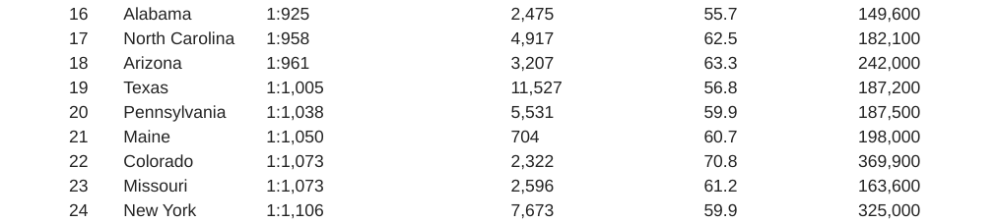
National Standings [2]
Figure 1. How Foreclosure Rates Compare to the Nation. Retrieved from https://www.thecentersquare.com/colorado/how-the-foreclosure-rate-in-colorado-compares-to-the-nation/article_c5d6a956-35b2-5e4e-a58e-62679aeb46b4.html
[9] There was a significant increase in the number of new foreclosure filings in 2022.
Denver 2023 Budget anticipates “a precipitous increase in filings since the moratorium ended and expects this trend to continue.”

Slide 4
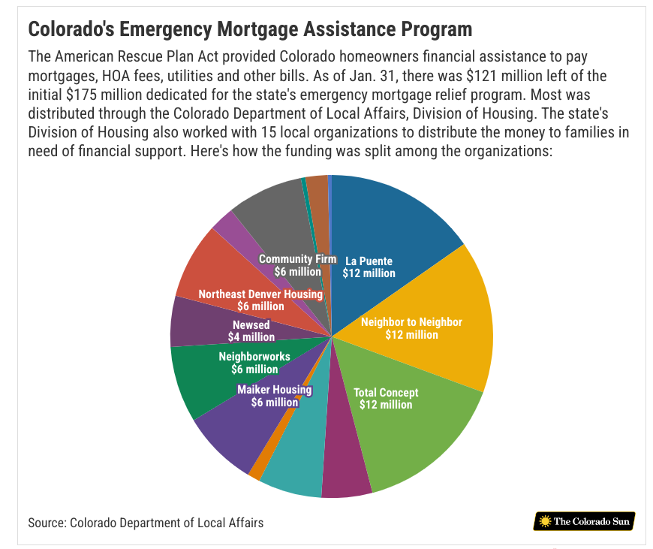
Denver Housing Assistance Programs
Denver Emergency Mortgage Program [3]
$175M from the American Rescue Plan Act (ARPA)
$10,000 to $40,000 for eligible homeowners
$125M unspent as of March 2023!
Denver 2023 Budget [9]
Allocated $77.7 million in ARPA funding

Slide 5
Issues With Awareness/Allocation
First-Come-First-Served Assumptions [4], [5], [6]
Seen as equitable
“If you care, you’ll respond fastest”
First-Come-First-Served Favors Those Who Have…
Time
Money
Independence
Knowledge
First-Come-First-Served Discriminates Against…
Poor
Disabled
Caregivers

Slide 6
Policy Suggestions
Use insights to focus on neighborhoods in need:
Increase awareness through phone, mail, billboard ads, townhalls
Increase access with door-to-door canvasing of high needs neighborhoods
Increase knowledge/capabilities with application workshops (Zoom or in-person options) and youtube tutorials [8]

Slide 7
Data Sets
Denver Neighborhood Data
Average Number of Foreclosures Per Year (2013 – 2016)
Number of Households in a Neighborhood
Denver 2023 Budget [9]
Community Outreach Budget*: $134,000
Impact on Participation by Type of Campaign
Call Center: 3.8% [16] [17]
Mail Campaign: 2% [17]
Bus Advertising: 26% [15]
Door-to-door Canvasing and Townhalls: 12% [17] [18]
* This is an estimate for community outreach budget based off of Denver’s Dept of Safety’s budget.

Slide 8
Data Sets (Cont)
Costs
Call Center Campaign: $2.70 – $5.60 [10]
USPS Postcard Campaign: $0.19 - $0.29 [11]
Bus Shelter Ad Per Display Per Week: $500 - $800 [12]
Door-to-door Canvasing: $19 per Household [13]
Townhall: $125 per hour (assume 4 hours for setup and teardown) [14]

Slide 9
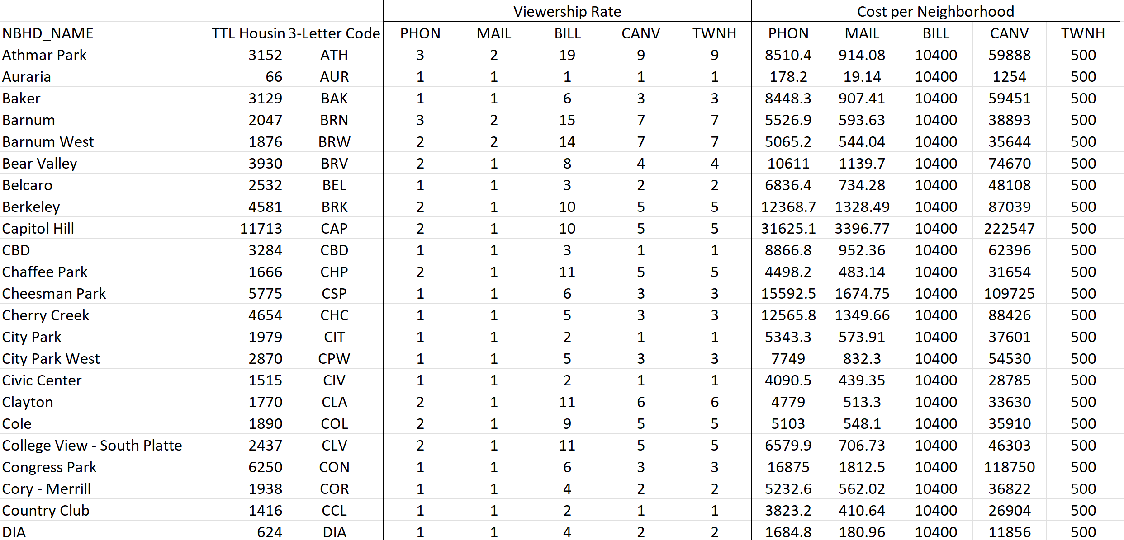
Model’s Data Table

Slide 10
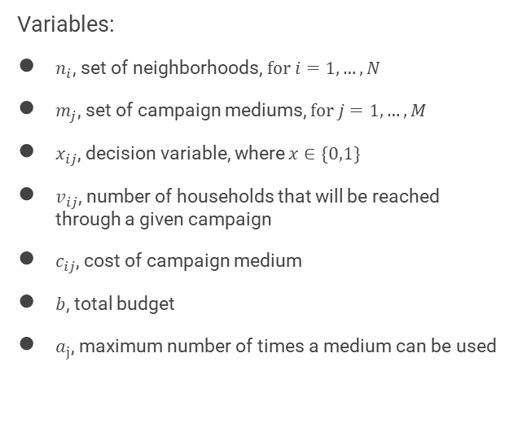

Knapsack Problem
Variables:
$n_{i}$, set of neighborhoods,$for i=1,…,N$
$m_{j}$, set of campaign mediums, $for j=1,…,M$
$x_{ij}$, decision variable, where $x∈\{0,1\}$
$v_{ij}$, number of households that will be reached through a given campaign
$c_{ij}$, cost of campaign medium
$b$, total budget
$a_{j}$, maximum number of times a medium can be used
Integer Program:
$$\max{\sum_{i=1}^{N}{\sum_{j=1}^{M}{v_{ij}x_{ij}}}}$$
$$s.t. \sum_{i=1}^{n}{\sum_{j=1}^{m}{c_{ij}x_{ij}≤b}}$$
$$\sum_{i=1}^{n}{x_{ij}≤a_{j}} ∀ j∈M$$
$$x_{ij}∈\{0,1\}$$
Notes:
We can use a classic knapsack integer program to maximize the value of these awareness campaigns under a budgetary restriction. This is an NP-Hard problem.

Slide 11
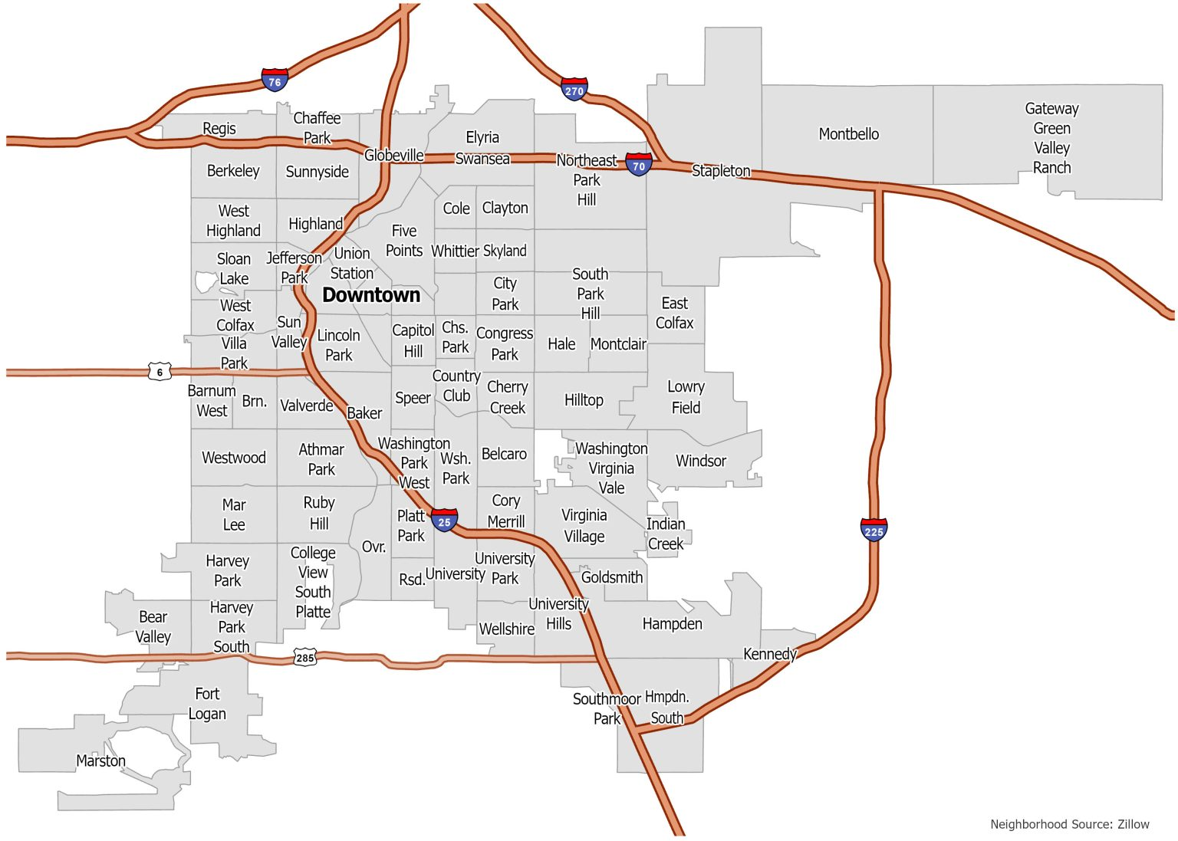
Results
DIA
Optimal Solution: 548 Households
Bus Advertisement
Mail Campaign
Phone Campaign
Townhalls

Slide 12
References
[1] Kingsley et al. “The Impacts of Foreclosures on Families and Communities.” Urban Institute of Washington, DC.
[2] Stebbins, S. The Center Square.com. “How the Foreclosure Rate in Colorado Compares to the Nation.” https://www.thecentersquare.com/colorado/how-the-foreclosure-rate-in-colorado-compares-to-the-nation/article_c5d6a956-35b2-5e4e-a58e-62679aeb46b4.html
[3] Flowers, T. The Colorado Sun. “Federal Housing Aid for Colorado Homeowners” https://coloradosun.com/2023/03/20/federal-housing-aid-for-colorado-homeowners/
[4] Autistic Inertia.com. “Why ‘first come first served’ is not fair.” https://autisticinertia.com/2022/04/why-first-come-first-served-is-not-fair
[5] Public Policy Institute of California (PPIC). “Equitable State Funding for School Facilities.” https://www.ppic.org/publication/equitable-state-funding-for-school-facilities/

Slide 13
References
[6] Aiken, C, et al. Russell Sage Foundation Journal of Social Sciences. “Administrative Burdens in Emergency Rental Assistance Programs.” https://www.rsfjournal.org/content/9/5/100
[7] GISgeography. “Denver Neighborhood Map.” https://gisgeography.com/denver-neighborhood-map/
[8] Government Accountability Office. “COVID-19 Housing Protections” https://www.gao.gov/products/gao-21-554
[9] Denver Annual Budget (2023). Local Government Filings Database. https://dola.colorado.gov
[10] Liveagent.com. “Cost Per Call.” https://www.liveagent.com/customer-support-glossary/cost-per-call/
[11] USPS.com. “Mail Campaign Costs.” https://www.uspsdelivers.com/direct-mail-cost-calculator/
[12] Blue Media. “Mass Transit Advertising.” https://www.bluelinemedia.com/bus-advertising/denver-co

Slide 14
References
[13] Philanthrophy.com. “Door-to-door Canvasing Cost.” https://www.philanthropy.com/article/cost-of-door-to-door-canvassing-is-19-per-vote-research-finds/
[14] Coloradononprofits.org. “Affordable Meeting Space for My Nonprofit.” https://coloradononprofits.org/faqs/where-can-i-find-affordable-meeting-space-for-my-nonprofit/
[15] Wilson, R. T, et al. International Journal of Advertising. “Using Transit Advertising to Improve Public Engagement with Social Issues” https://par.nsf.gov/servlets/purl/10275969
[16] Nickerson, D. American Politics Research, Vol 34, Number 3, May 2006.“Volunteer Phone Calls Can Increase Turnout”
[17] Gerber, A, et al. American Political Science Review, Vol 94, Number 3, Sep 2000. “The Effects of Canvassing, Telephone Calls, and Direct Mail on Voter Turnout: A Field Experiment”
[18] Sinclair, B, et al. Political Communication, 2013. “Local Canvassing: The Efficacy of Grassroots Voter Mobilization”

